Slide 1
GEOG-G489/589 Python Programming
Instructor: Natasha MacBean
Dictionaries, More on netCDF files and 2D array plotting with imshow()

Slide 2
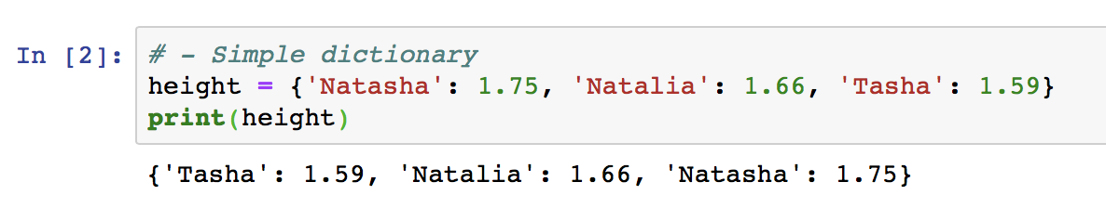
Simple Dictionaries

Slide 3
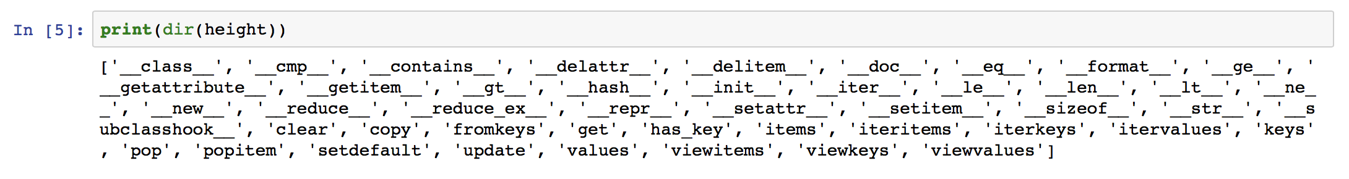
Accessing methods of an object using dir()

Slide 4
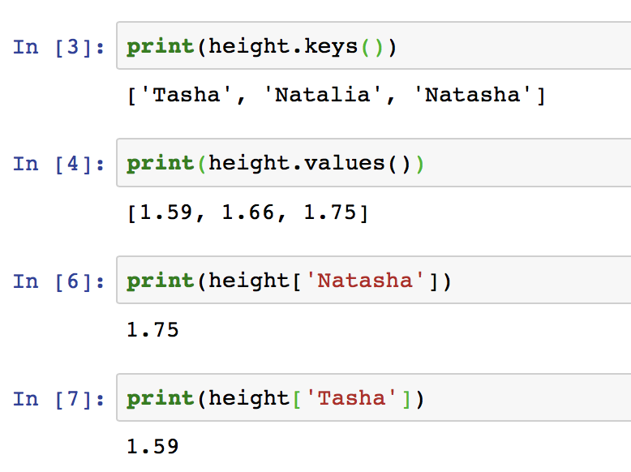
Simple Dictionaries

Slide 5
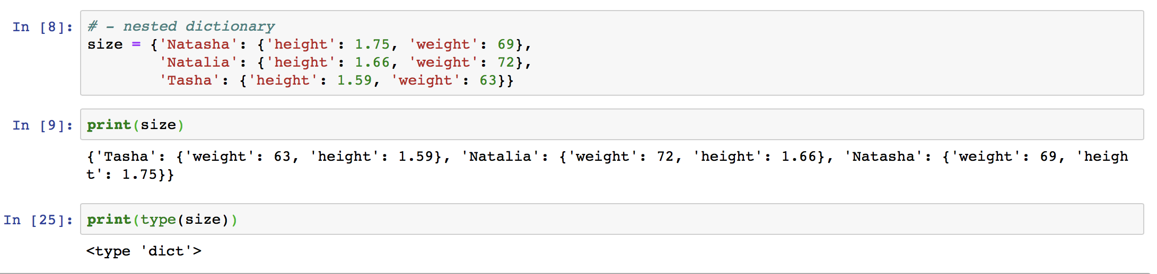
Nested Dictionaries

Slide 6
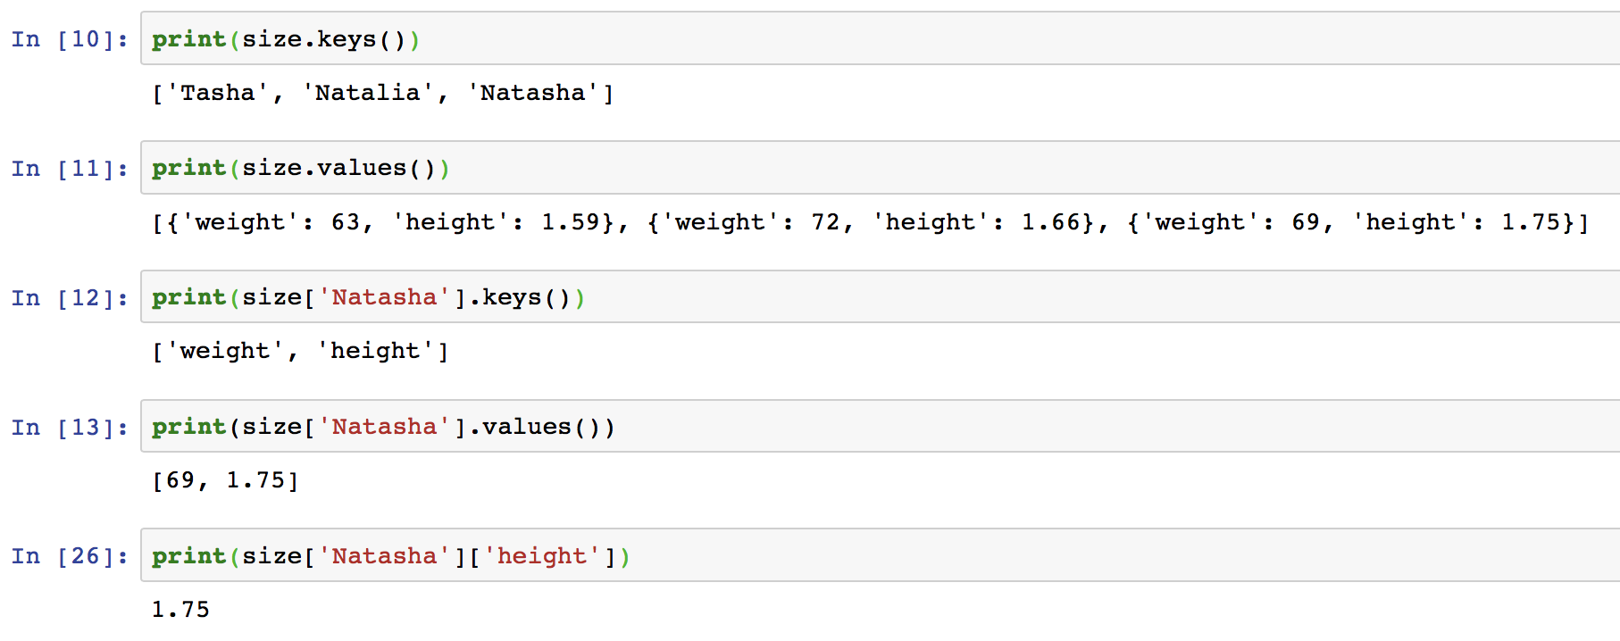
Nested Dictionaries: accessing information

Slide 7
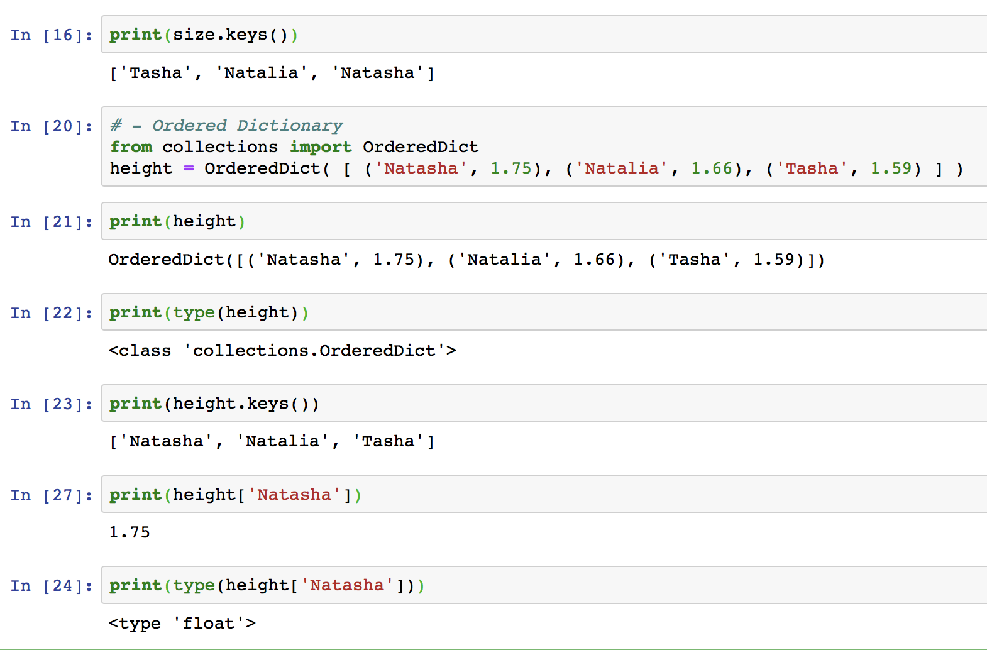
Ordered Dictionaries → why do we need them?
If you want a dictionary in which the keys are sorted in a specific way, then use an Ordered Dictionary
From ”collections” python library: https://docs.python.org/2/library/collections.html#collections.OrderedDict

Slide 8
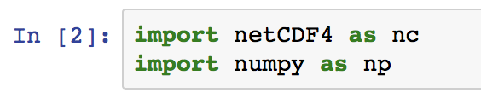

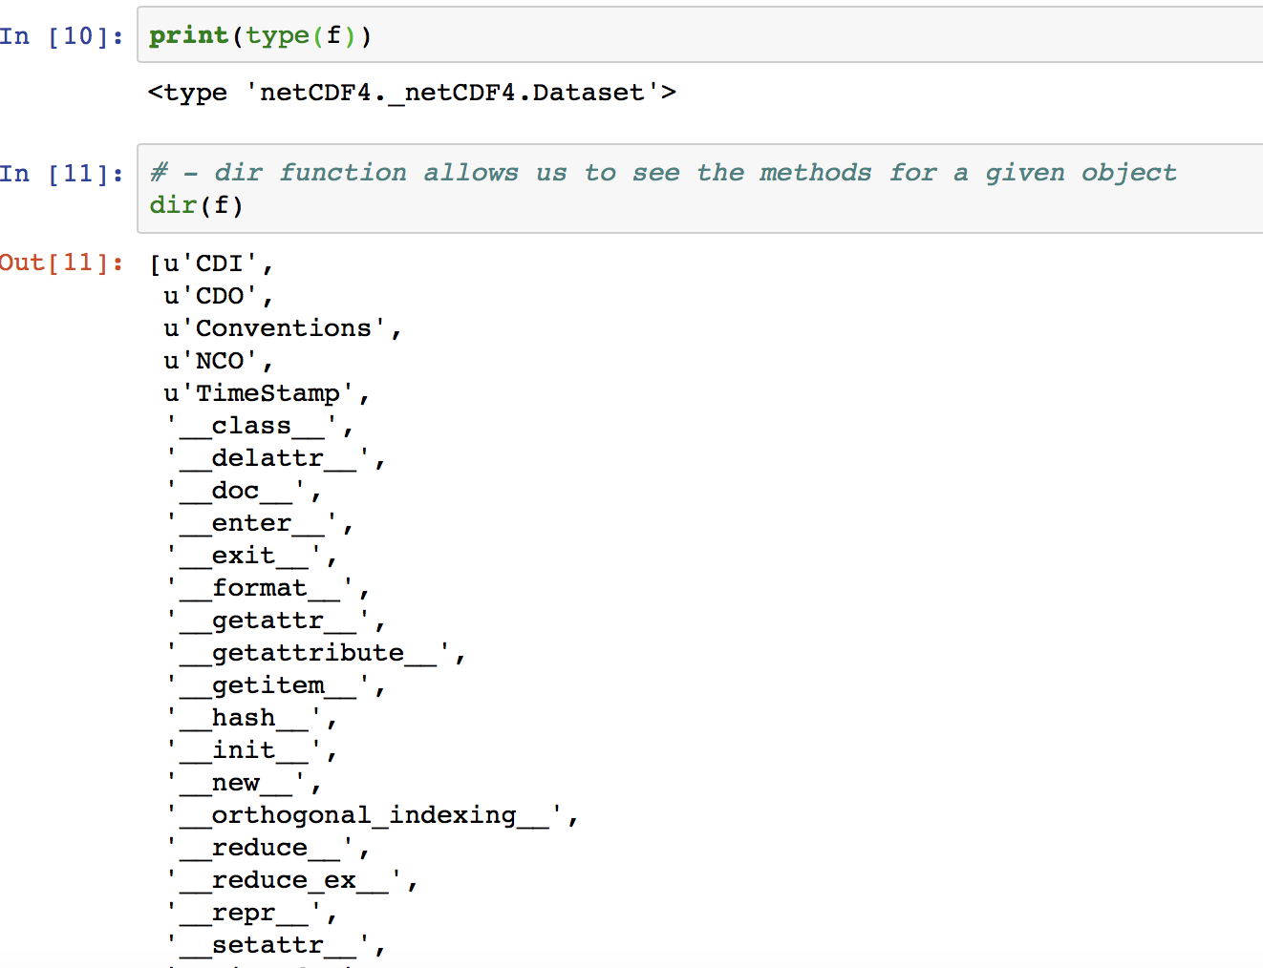
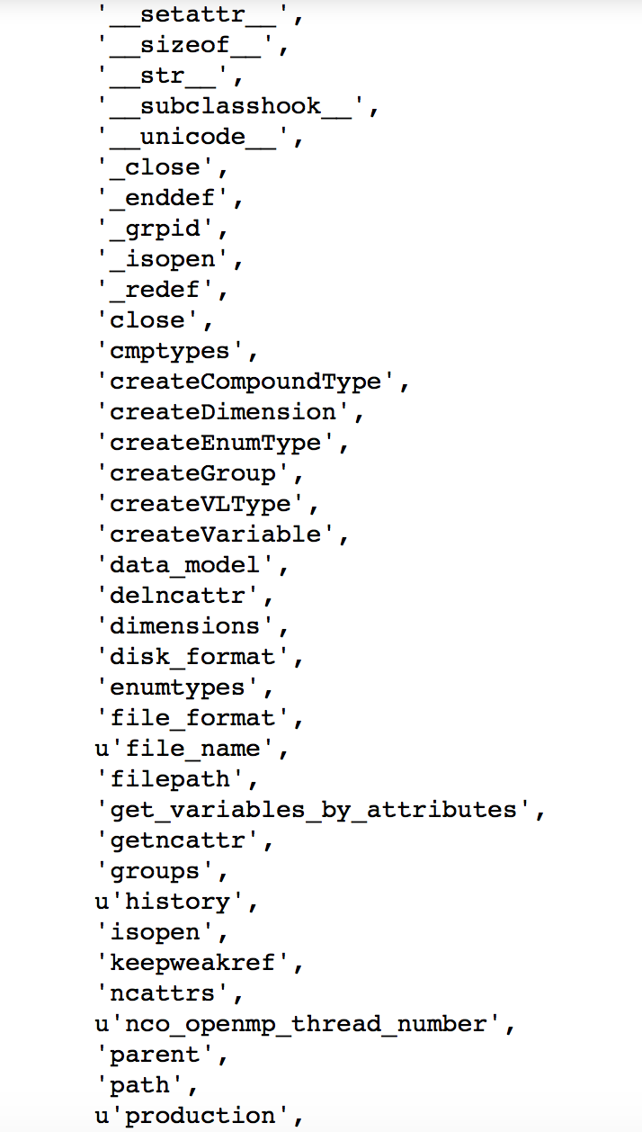
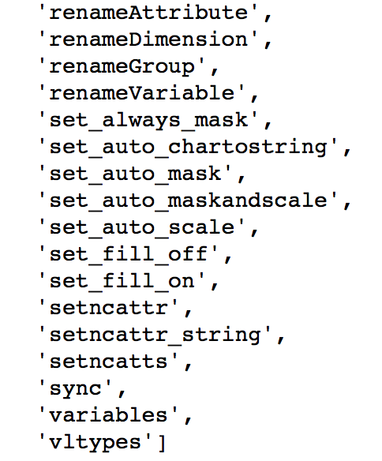
More on netcdf files

Slide 9
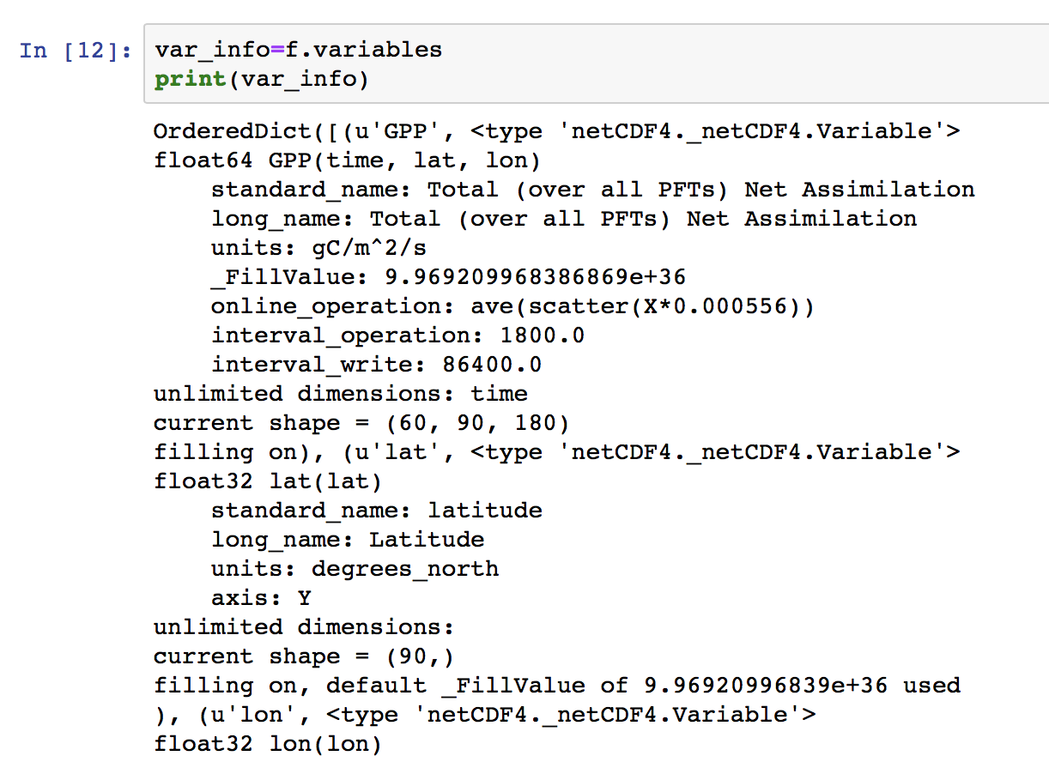
Accessing information on the variables

Slide 10
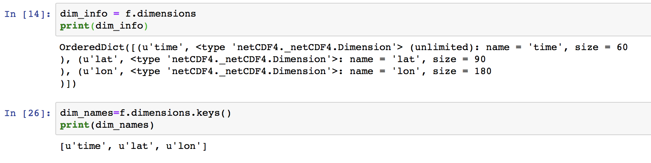
Accessing information on the dimensions

Slide 11
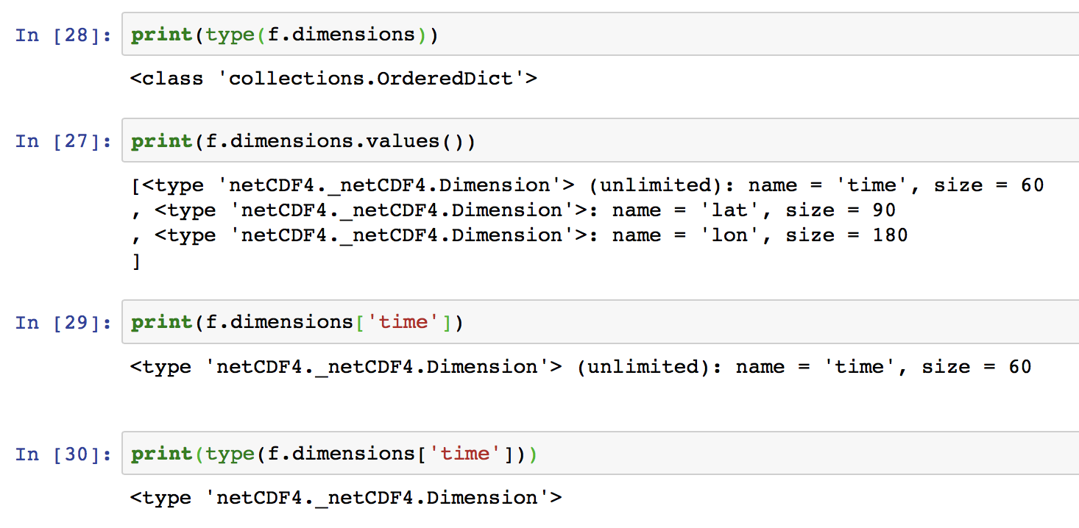
Accessing information on the dimensions

Slide 12
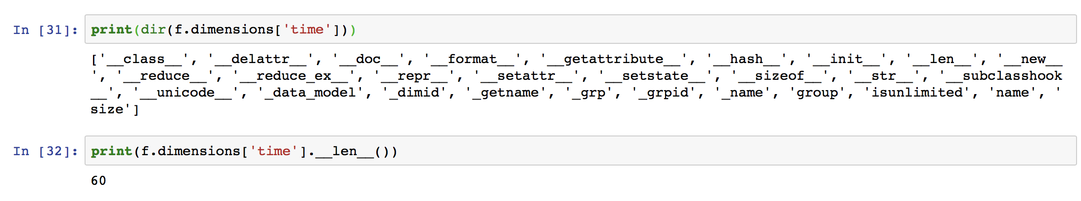
Accessing information on the dimensions

Slide 13
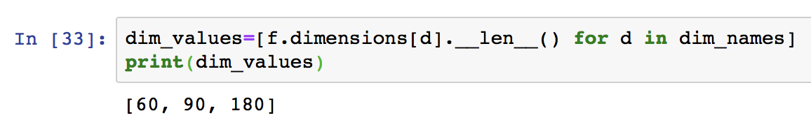
Neat trick for creating a list using list comprehension
All within square brackets to create a list
Part inside for loop at beginning
For loop at end
https://www.datacamp.com/community/tutorials/python-list-comprehension
https://www.programiz.com/python-programming/list-comprehension

Slide 14
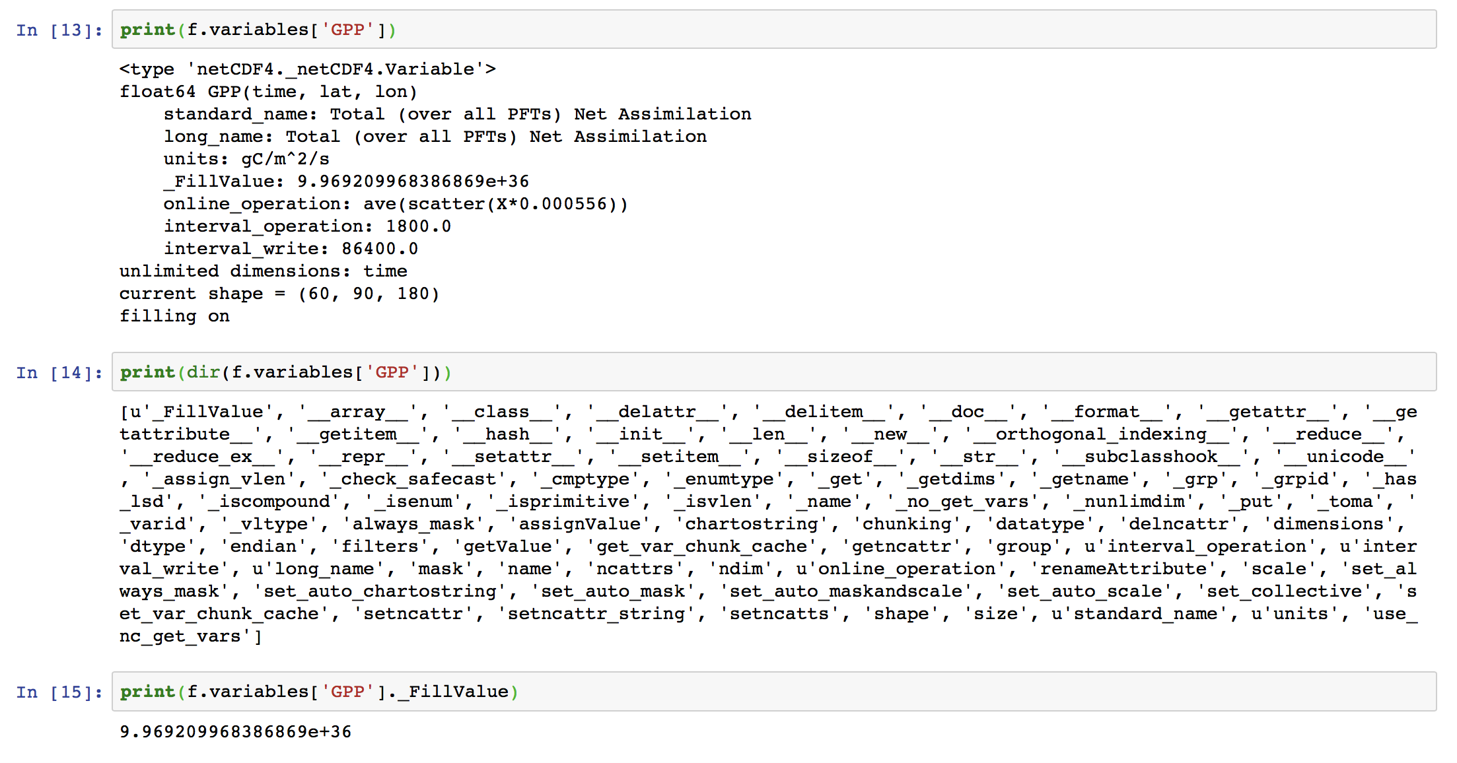
Accessing attribute values like FillValue

Slide 15
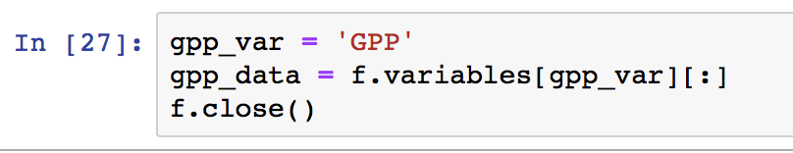
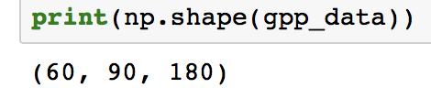
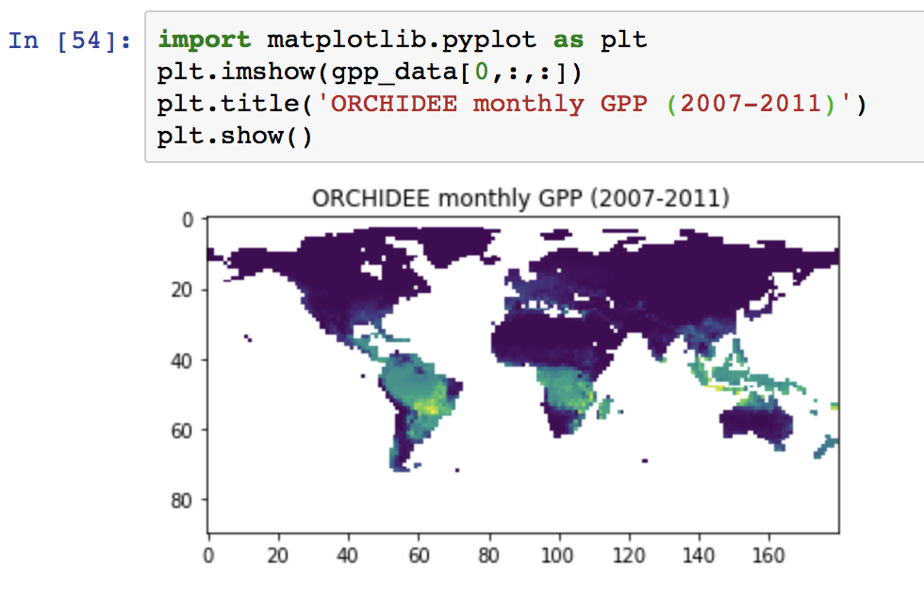
Plotting simple images with imshow()
Which time period have I plotted?

Slide 16
Today’s in-class exercise
Our scientific objective is to do a quick exploratory plotting data analysis to see how GPP changes over the year.
Take the next 5 minutes to think how we would do this and the steps we would need?

